Slide 1

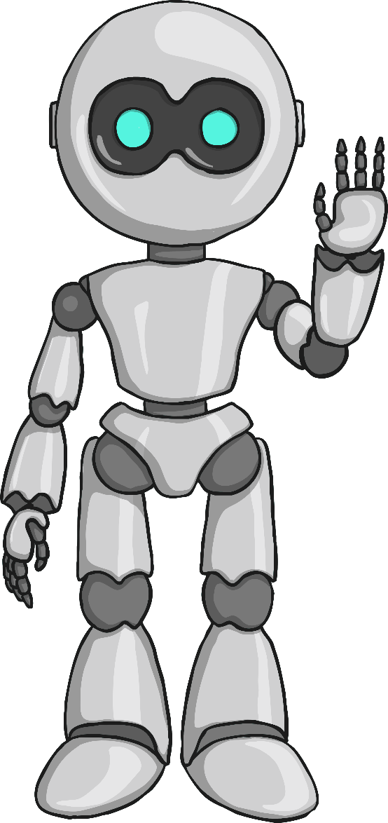



Build-a-thon: AI/ML Driven Low Latency Closed Loop Control
IIT-Bhilai
IIT-Delhi
ITU
Team Members(AI_ML_SSD)
Dr. Sk Subidh Ali
Professor(Mentor)
IIT Bhilai
Mr. Debanka Giri
Project Scientist
IIT Delhi
Mr. Sudev Kumar Padhi
Research Scholar
IIT Bhilai
Mr. Mohit Kumar
B.Tech Student
IIT Bhilai

Slide 2

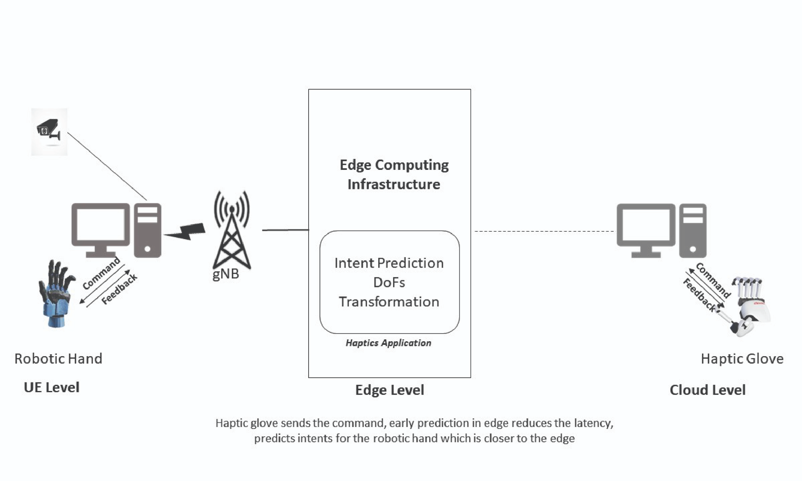

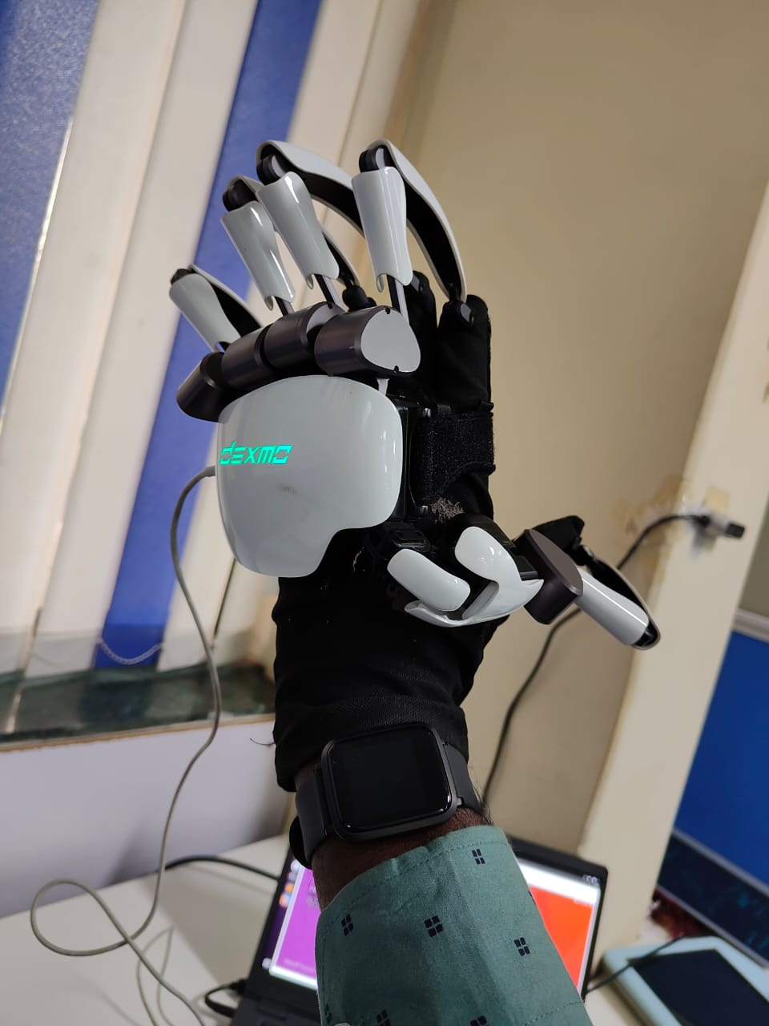
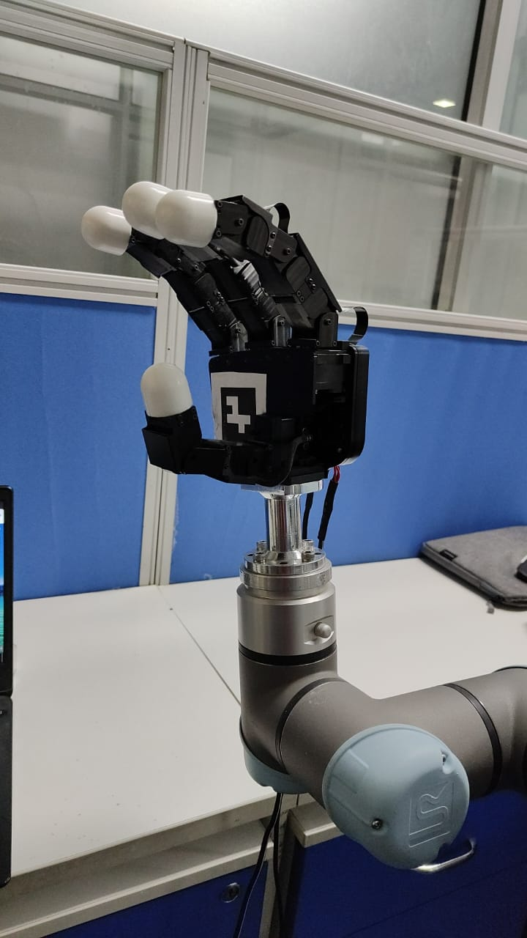
Introduction
Introduction
Closed Loop Control
Tele Surgery, Remote area installation
Haptic Glove
Robotic hand

Slide 3
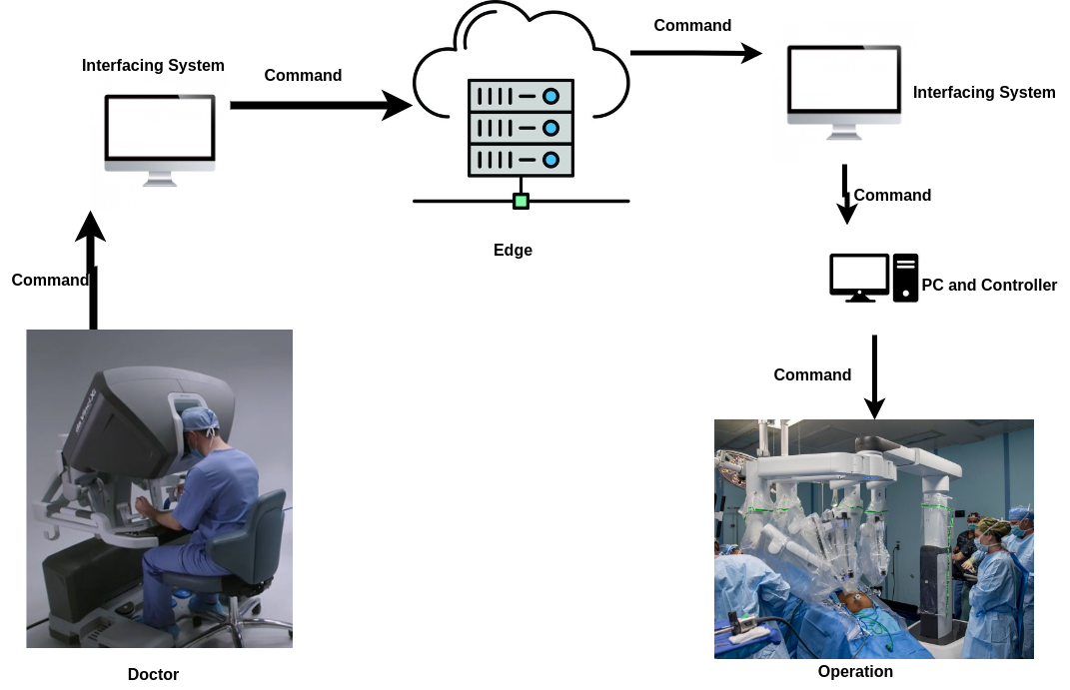
Use of Haptics Technology
Tele Surgery using in operating robotic hand remotely is increasing.
But Achieving human level robustness has long been a challenging problem in the robotic community.

Slide 4
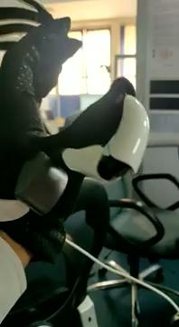
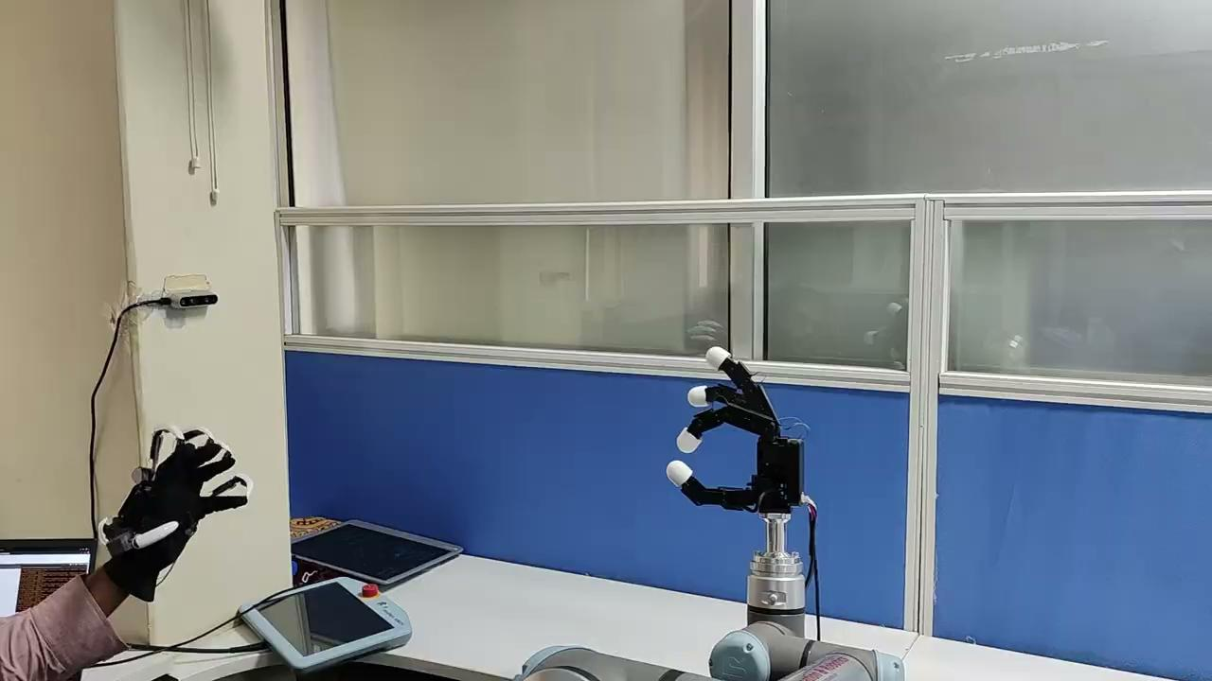
Issues in Closed Loop
High-Latency in the loop.
Requires a proficient operator.
Slip and crumple detection.

Slide 5


Problem Statements
Problem Statement - I: (Slip Detection & Force Estimation)
Overall this task requires an estimation of the force to be applied on the object for a successful grasp in a latency aware closed loop.
Leverage latency-aware learning technique to
Find if the object is about to slip.
Find if the object is about to crumple.
Problem Statement - II: (Object Detection)
The Robotic Hand records its current states (in the form of angular configuration and forces exerted on its joints).
Using this modalities detect the shape of the object so that the object can be grasped quickly making the feedback of the robotic arm processed faster and making the closed loop lag free due to low latency.
In future we will apply the appropriate control to prevent the slip in a latency aware manner.

Slide 6
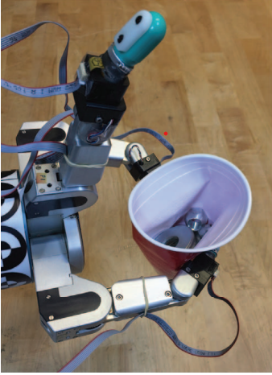
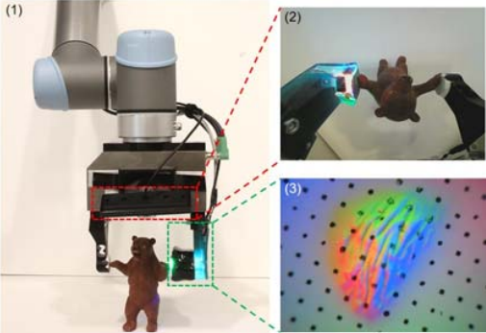
Existing Approaches
Slip Detection/Classification for grip control using a biomimetic tactile sensor which
calculates friction coefficient from micro vibration.
Slip Detection with Combined Tactile and Visual Information.
Slip Detection with Combined Inertial(accelerometers) and Visual Information.
Our approach only uses actuators informations which has some advantages:
Faster processing of feedbacks which reduces latency in closed loop as visual information takes time to process increasing latency.
Visual information may be incorrect for certain angle in the robotic arm at and it does not provide information about change in grip.
Biomimetic sensor and inertial sensor as individual do not yield good accuracy for sudden slips.

Slide 7
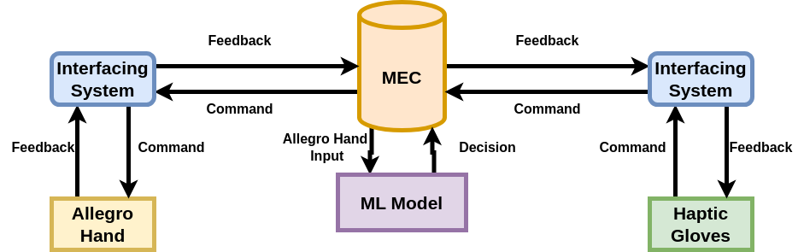
Our Solution in closed loop
ML model can solve our problem.

Slide 8
Problem Statement -1: Slip Detection and Force Estimation
Problem Statement : I
Given an object being held by an Allegro Hand. The object may tend to slip or crumple from the grip
Our aim is to predict if the object is slipping and Crumpling using ML models.
Inputs:
Force and angle made by the sixteen actuators of the allegro hand with the object.
Mass and the shape of the object.
Outputs:
Values for slip and crumple.
Action | Yes | No
Slip | 1 | 0
Crumple | 1 | 0

Slide 9
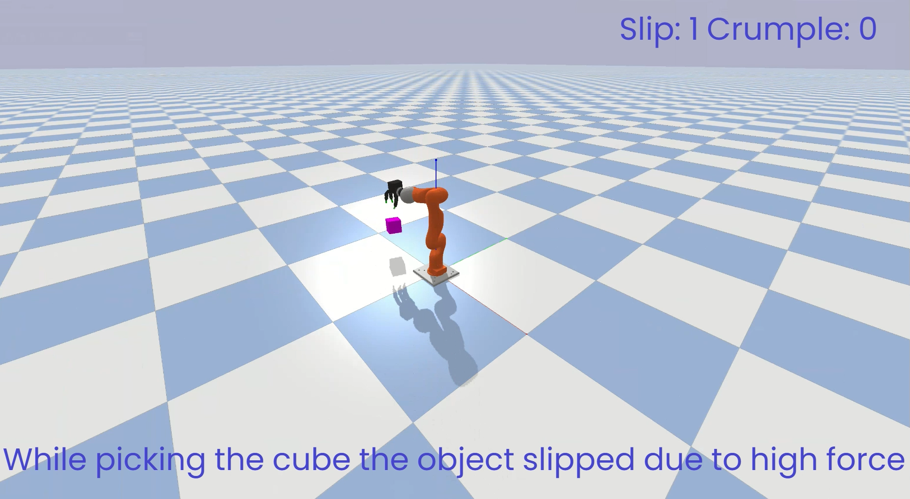
What is slipping ?

Slide 10
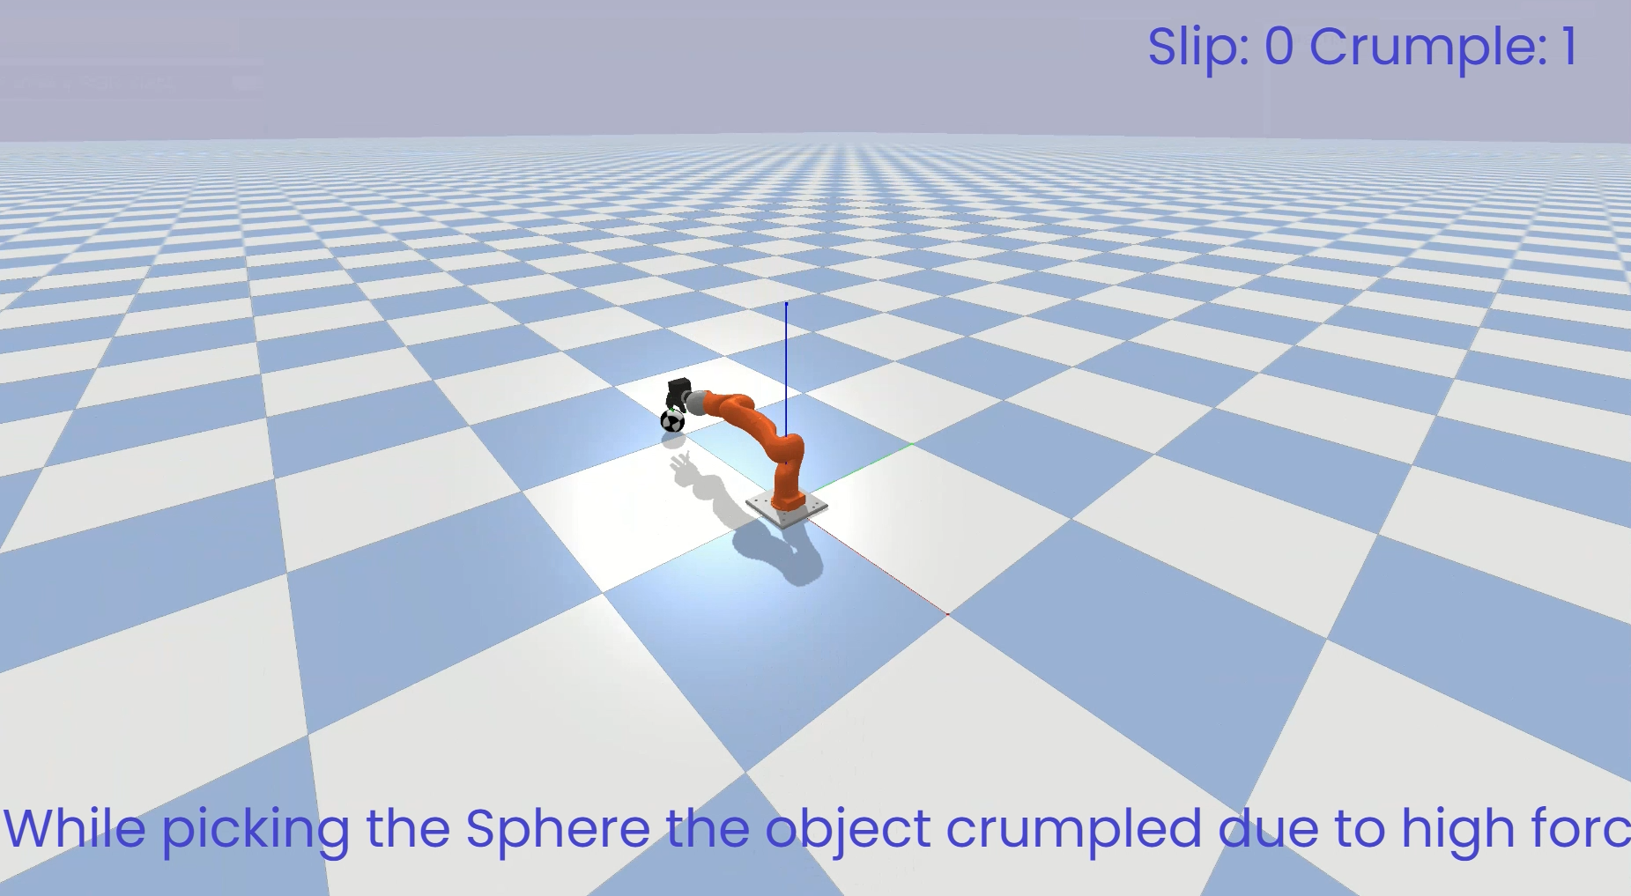
What is crumpling ?

Slide 11
Problem Statement -2: Object Detection
Problem Statement : II
The object is currently held by an Allegro hand.
Our aim is to predict the shape of the object from 13 different shapes using an ML model.
Inputs:
Force and angle made by the sixteen actuators of the allegro hand with the object.
Mass of the object.
Outputs:
Shape of the object which is being held.
The shape of the object could be a sphere, cube, or cuboid with different dimensions.

Slide 12
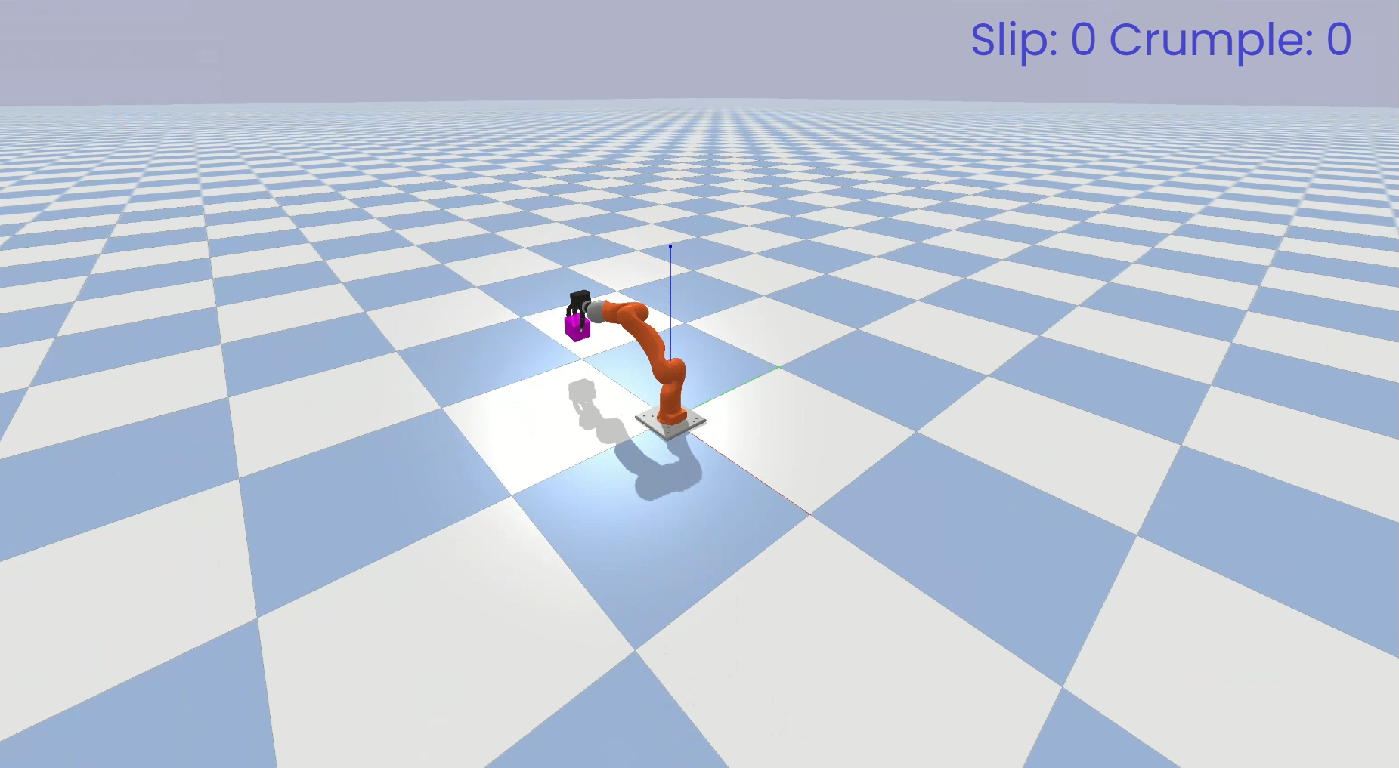
Shape Detection of Cube

Slide 13
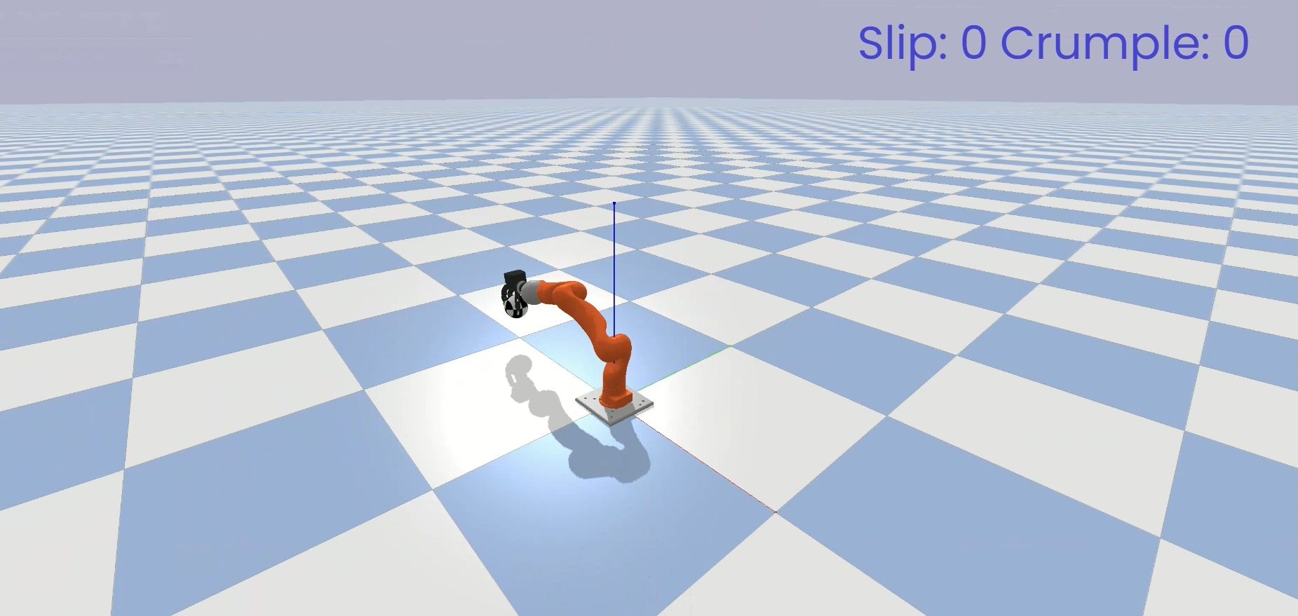
Shape Detection of Sphere

Slide 14
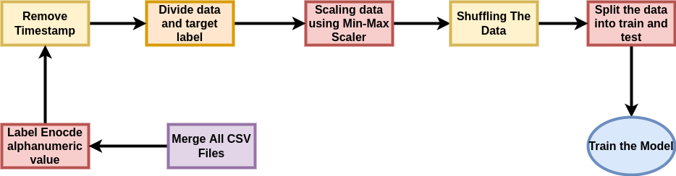
Design
Problem statement I: (Slip Detection and Force Estimation)
Timestamp data was given to predict slip and crumple.

Slide 15
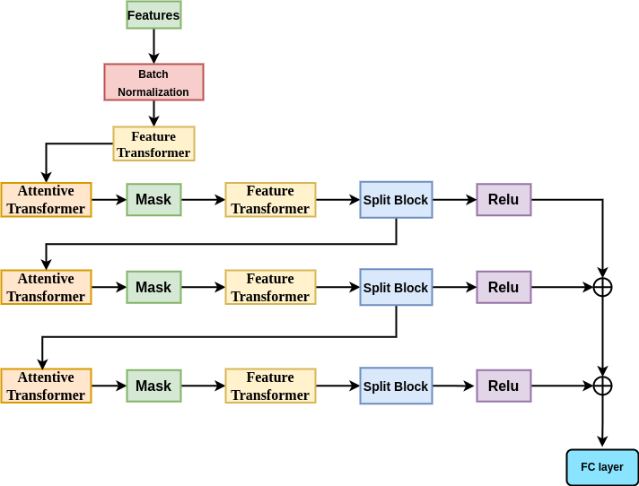
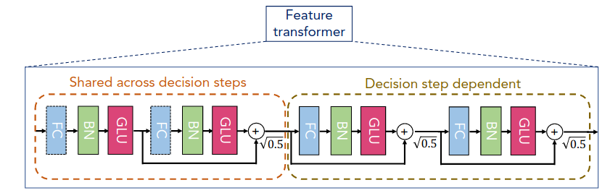
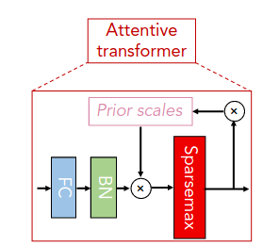
Experimental Methodologies

Slide 16
Hyperparameter Space
Framework used | Pytorch
Learning rate | 0.02
Optimizer | Adam
Loss Function | Cross Entropy
Momentum | 0.02
Model Type | Deep Neural Network
Epochs | 100
Validation Split | 0.16 percent of whole data
Batch Size | 2048

Slide 17
Comparison
Models | Proposed Model | DNN(10 layers) | DNN(50 layers) | LSTM
Validation accuracy | 93.2 | 86.2 | 88 | 89.4
Training Accuracy | 93.7 | 87 | 89 | 90.1
Loss | 0.13521 | 0.26 | 0.22 | 0.18

Slide 18
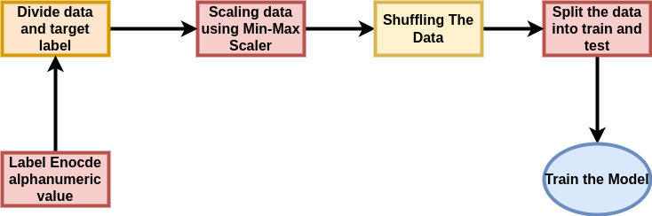
Design - Problem statement II: (Object Detection)

Slide 19
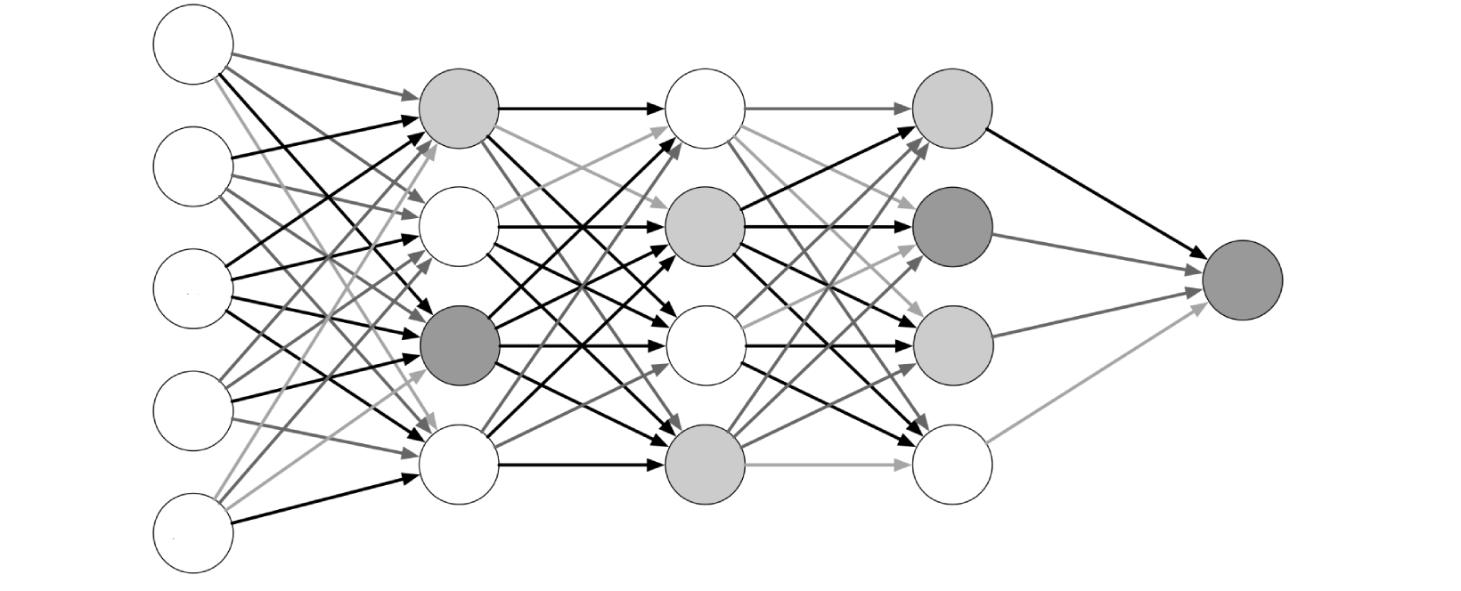
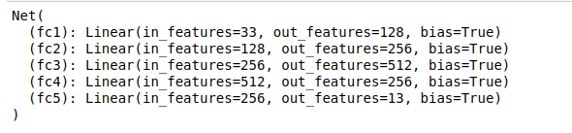
Experimental Methodologies

Slide 20
Hyperparameter Space
Framework used | Pytorch
Learning rate | 0.002
Optimizer | Adam
Loss Function | Cross Entropy
Momentum | 0.02
Model Type | Deep Neural Network
Epochs | 200
Validation Split | 10 Fold validation
Batch Size | 2048

Slide 21
Comparison
Models | Proposed Model | DNN(15 layers) | DNN(10 layers) | LSTM
Validation accuracy | 99.7 | 99.6 | 98.9 | 94.6
Training Accuracy | 99.8 | 99.8 | 99.2 | 95.4
Loss | 0.014 | 0.019 | 0.024 | 0.05

Slide 22
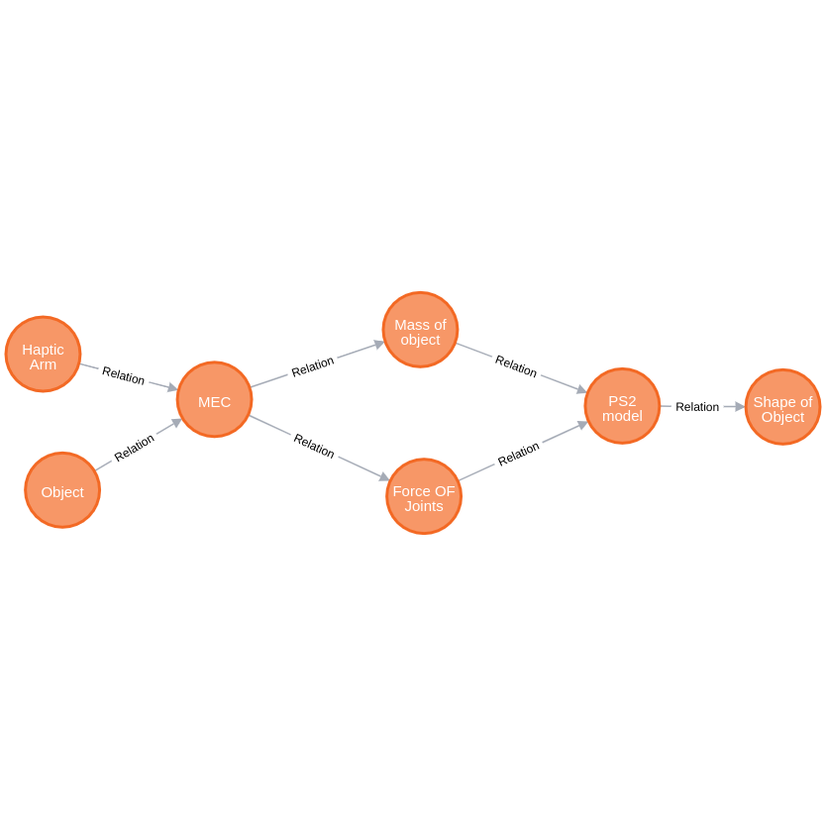
Graph: (Object Detection)

Slide 23
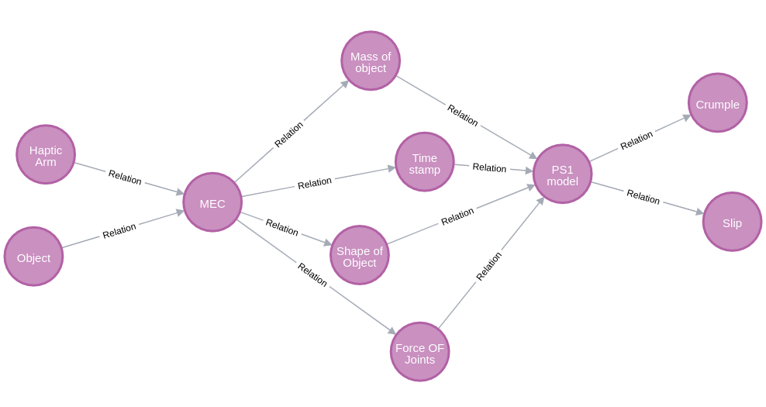
Graph: (Slip Detection and Force Estimation)

Slide 24


